Slide 1

PROJECT REPORT ON DATA ANALYSIS OF CUSTMOR RETENTION
SUBMITTED BY:
MR. HRITIK YADAV
SUBMITTED TO:
MS. KHUSHBOO GARG

Slide 2
ACKNOWLEDGMENT
I WOULD LIKE TO GAVE MY GRATITUDE TO ‘FLIP ROBO’ WHO GAVE THIS WONDERFULL OPPORTUNITY TO WORK ON THIS DATASET PROJECT ASLO HEARTFUL THANK TO ‘KHUSHBOO MAM’ TO CLEAR MY CONFUSIONS AND DOUBTS.
THE SKILLS WHICH USE TO COMPLETE THE PROJECT
DATA VISULIZATION- MATPLOTLIB, SEABORN
PANDAS LIBRARY
NUMPY LIBRARY
EDA KNOWLEDGE

Slide 3
INTRODUCTION
ABOUT:-
Customer satisfaction has emerged as one of the most important factors that guarantee the success of online store; it has been posited as a key stimulant of purchase, repurchase intentions and customer loyalty. A comprehensive review of the literature, theories and models have been carried out to propose the models for customer activation and customer retention. Five major factors that contributed to the success of an e-commerce store have been identified as: service quality, system quality, information quality, trust and net benefit.
The research further more investigated the factors that influence the online customers repeat purchase intention. The combination of both utilitarian value and hedonistic values are needed to affect the repeat purchase intention (loyalty) positively. The data is collected from the Indian online shoppers. Results indicate the e-retail success factors, which are very much critical for customer satisfaction.

Slide 4
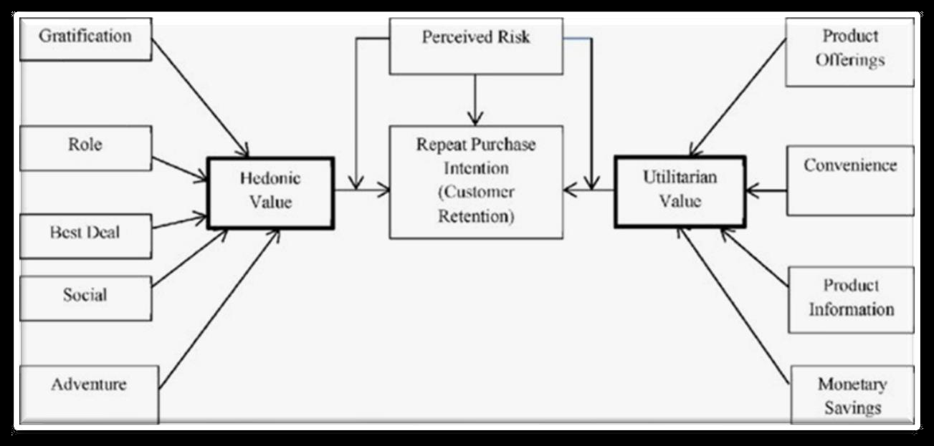

Slide 5
3. THE MOTIVE OF THIS PROJECT THAT IS GAVE BY ‘FLIP ROBO’ TO INHANCE MY DATA SCIENCE SKILL AND INCREASE THE KNOWLEDGE OF VISULIZATION, THE DATAFRAME HOLDS THE DATA OF SURVEY CUSTMOR RETENTION.
THE SURVEY TAKES DIFFERENT DIFFERENT VIEW POLINTS OF MALE AND FEMALE CUSTMOR ON E-COMMERCE PLATFORMS WEBSITE.ALSO THE DETAILS OF THE USERS ON BASIS OF FACTORS LIKE AGE, GENDER, CITY ETC.

Slide 6
ANALYTICAL PORTION
CONNECTED WITH DATAFRAME:-
THE DATA IS TAKEN FROM THE INDIAN ONLINE SHOPPERS. THE DATA HOLDS CUSTMORS OPNION ON ONLINE RETAILER STORES.
THE DATA PROVIDED BY ‘FLIP ROBO’ IN SECOND SHEET IN EXCEL FILE.
TO CONNECT WITH THE SHEET USE PANDAS LIBRARY READS METHOD
THE DATA FRAME HAVE (269) ROWS, AND (71) COLUMNS. WE CAN FIND BY USING DATAFRAME.SHAPE METHOD. OUT OF WHICH 1 FEATURE WITH ‘INT’ AND OTHER FEATURING ‘OBJ’

Slide 7
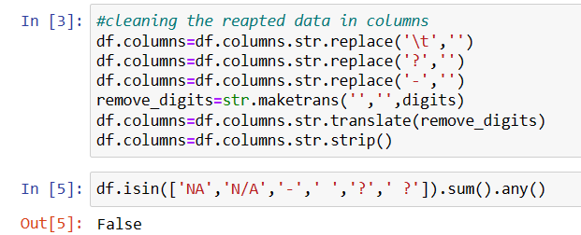
2. DATA-CLEANING AND PRE-PROCESSING:-
IN THE DATAFRAME THEIR ARE TABS(‘\T’),(‘?’),(‘-’) WHICH NEEDS TO BE CLEAR FOR BETTER UNDERSTANDING OF DATA .
ALSO REVOME THE DIGITS IN THE COLUMNS BECAUSE SOME COLUMNS HAD THE DIGITS BUT MAINLY COLUMNS DO NOT.

Slide 8
3. HARDWARE AND SOFTWARE USED IN THE PROJECT:-
Hardware Used -
1. Processor — Intel i3 processor with 2.4GHZ
2. RAM — 4 GB
3. GPU — 2GB AMD Radeon Graphics card
Software utilised -
1.Anaconda – Jupyter Notebook
Libraries Used –
Different libraries are used while building ML model and Visualisation of data.

Slide 9
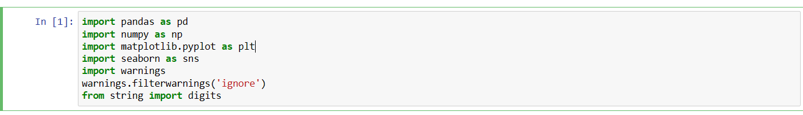
PANDAS FOR DATAFRAME
NUMPY FOR BASIC
MATPLOTLIP.PYPLOT FOR DATA VISUALIZATION
SEABORN FOR PLOTING GRAPHS
WARNINGS FOR FILTERING THE WARNINGS

Slide 10
4. IDENTIFICATION OF DATA ON THE BASIS OF DIFFERENT CATEGORIES
THEIR IS LOT OF DATA PRESENT IN THE DATASET, SO WE HAVE TO FIRST IDENTIFIED THE DATA WHICH IS USEFUL
with respect to time.
on the basis of good performance.
with respect society(easy to use, secure, multipules window,etc).
on the basis of payment system.
on the basis of gender, browser ,region, operating system,etc.

Slide 11
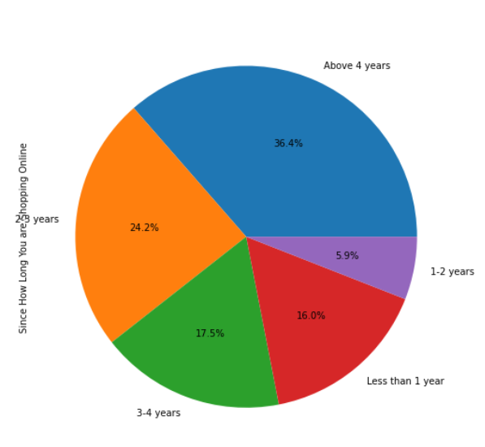
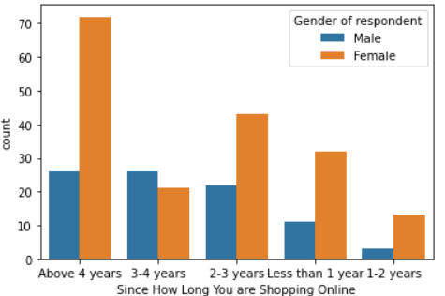
5.START EDA(EXPLORATORY DATA ANALYSIS)
ON THE BASIS OF YEAR AND TIME
THE MAJORITY OF FEMALES WERE SHOPING ABOVE 4 YEARS
MAJORITY OF MALES WERE SHOPING 2-3 YEARS
their are 36.4% people who shope more then 4 years
72+26=98 total people who shope more than 4 years
26.7% female and 9.66% male shope more then 4 years

Slide 12
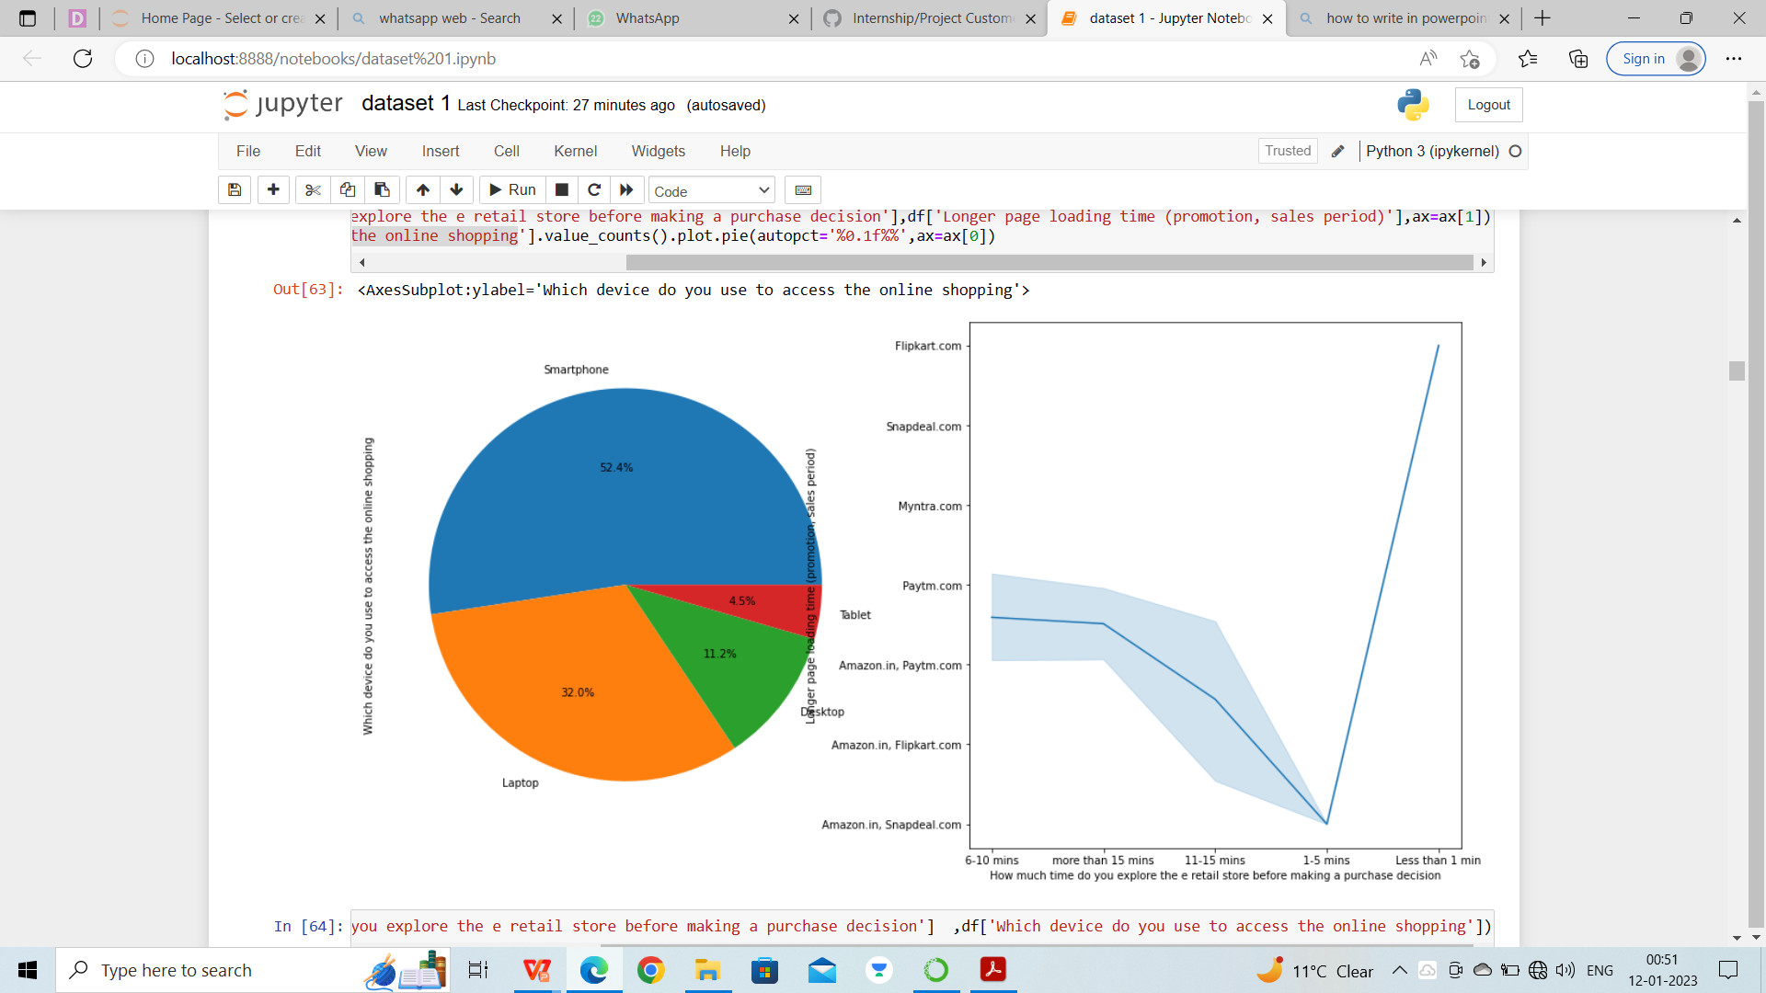
more than 15 mins people sends their time on paytm ,and less then 1 min people sends on flipkart.com, on average people sends 11-15mins on all platforms
we had some excited data the user that use laptop spends more then 15 mins to explore the window,the smart phone user

Slide 13
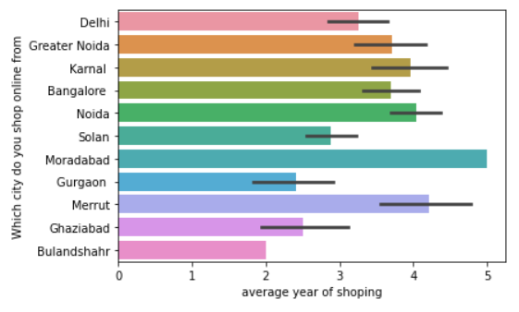
from moradabad average people shope online from 5 years
from maximum sates shope online from 4 years
the bulandshahr state start shoping 2 year earlier

Slide 14
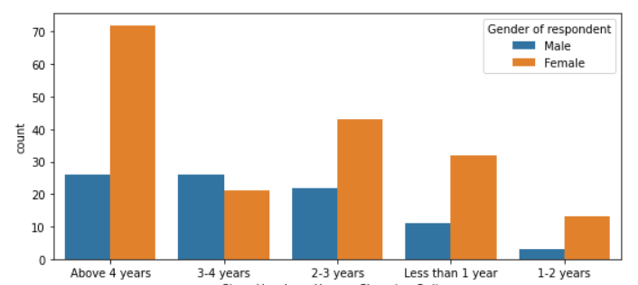
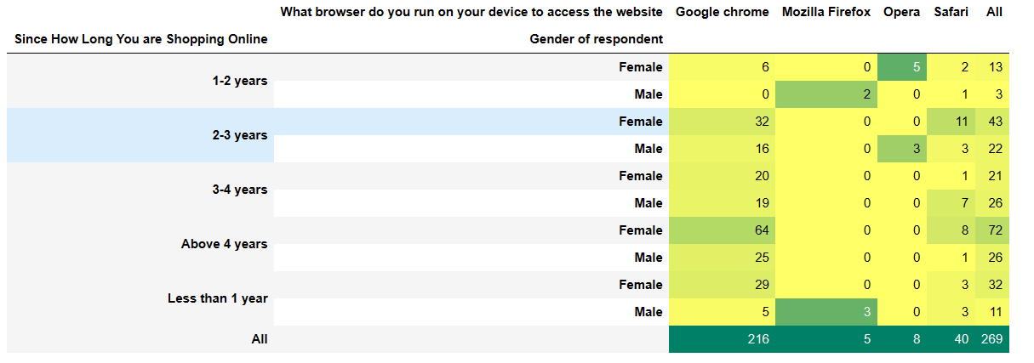

Slide 15
people who has been shope from above 4 years female has upperhand hand then male
their is only a group of 3-4years people where male shope more then women
the marjority of females and males use chrome

Slide 16
2. ON THE BASIS OF GOOD PERFORMANCE
Easy to use website or application
Visual appealing web-page layout
Wild variety of product on offer
Complete, relevant description information of products
Fast loading website speed of website and application
Reliability of the website or application
Quickness to complete purchase
Availability of several payment options
Speedy order delivery
Privacy of customers’ information

Slide 17
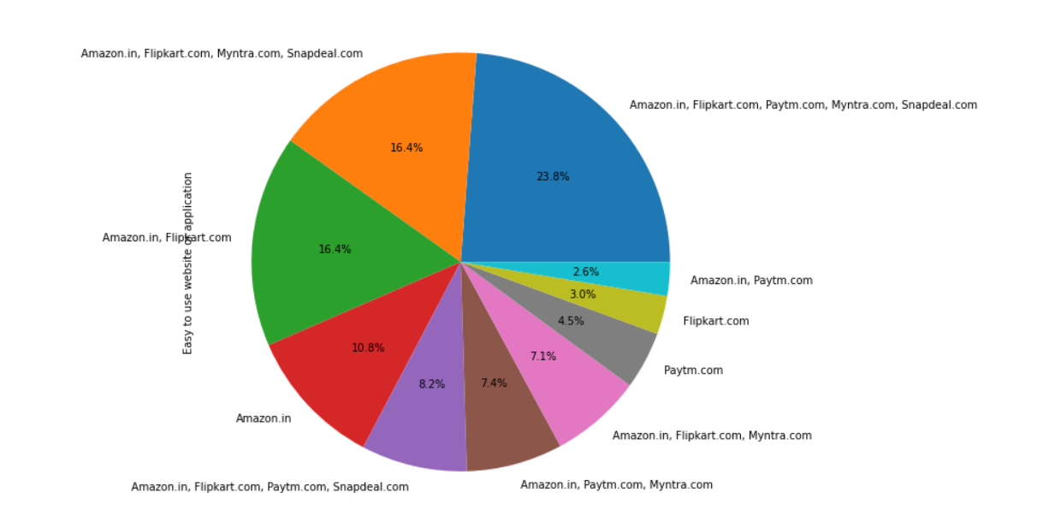
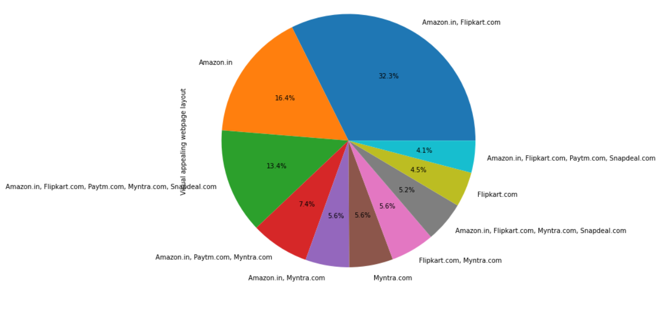
EASY TO USE WEBSITE APPLICATION
Visual appealing web-page layout

Slide 18
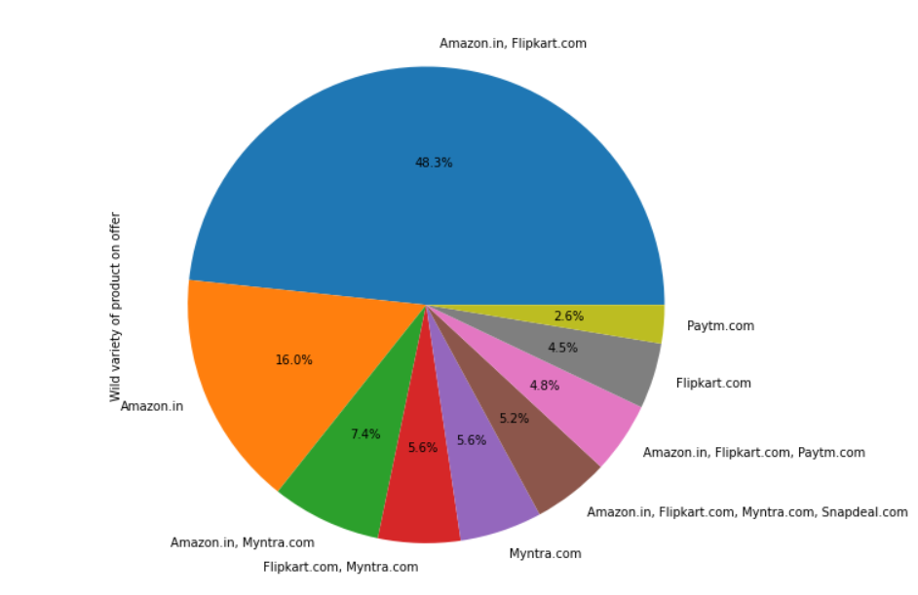
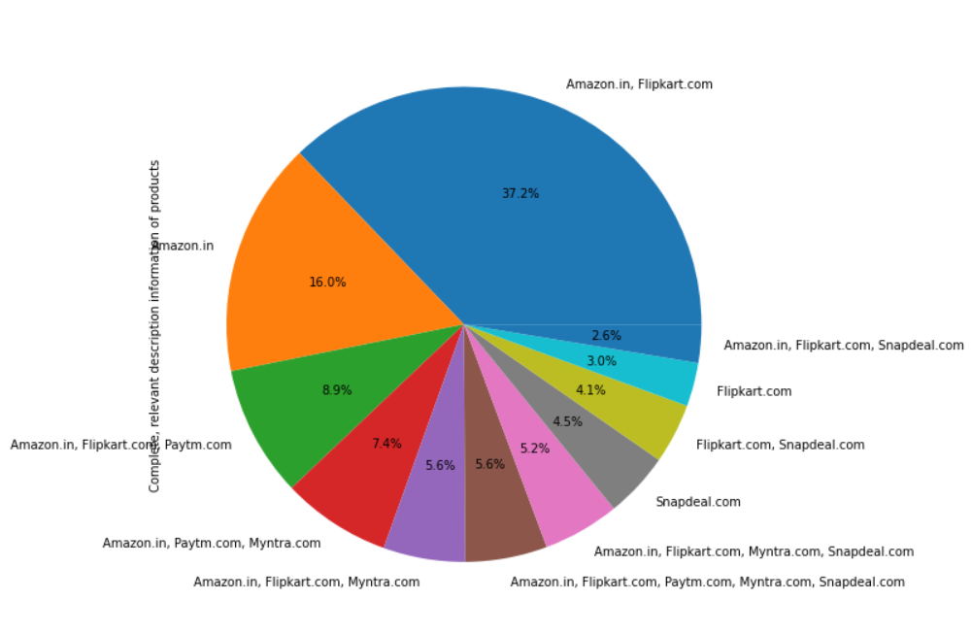
Wild variety of product on offer
Complete, relevant description information of products

Slide 19
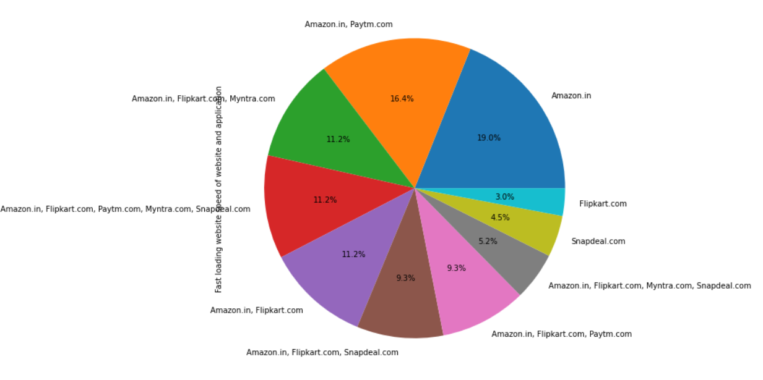
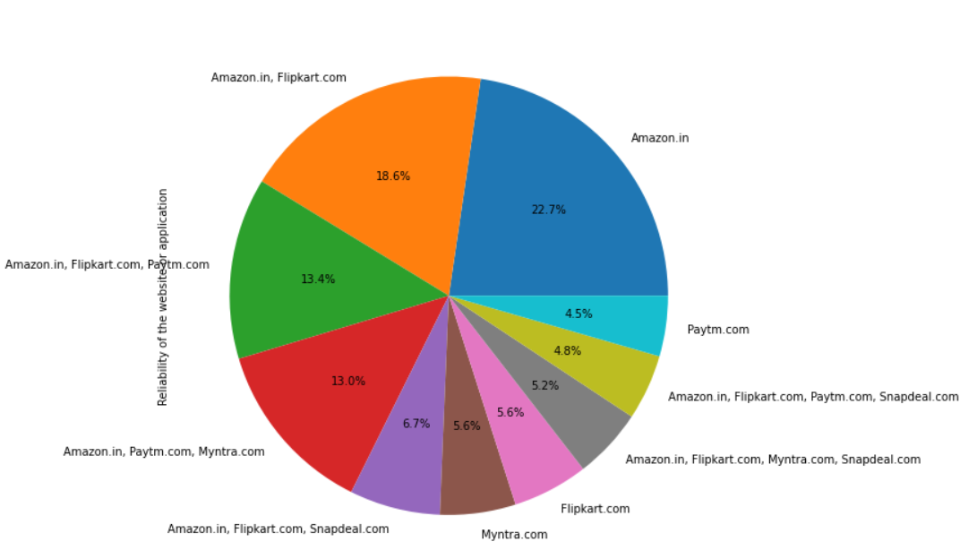
Fast loading website speed of website and application
Reliability of the website or application

Slide 20
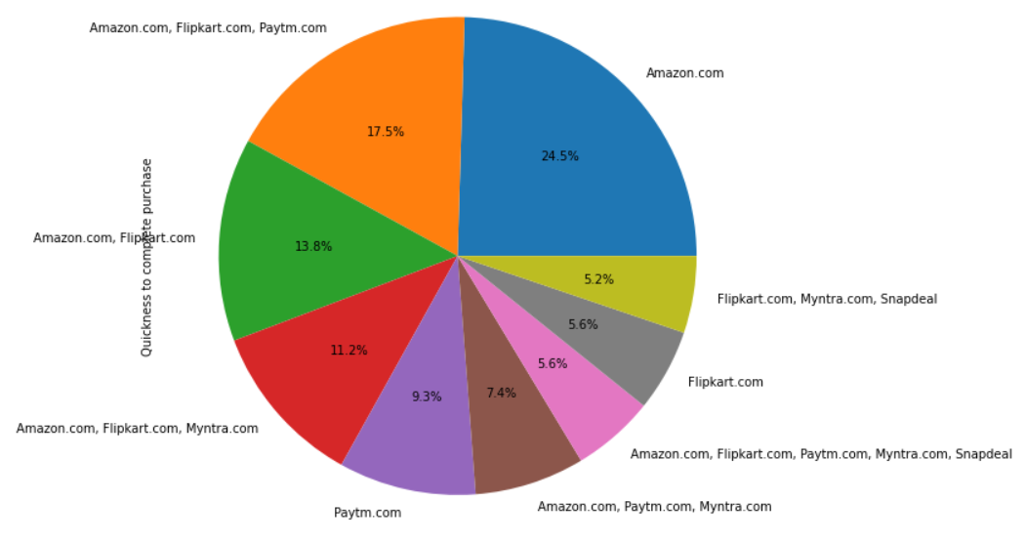
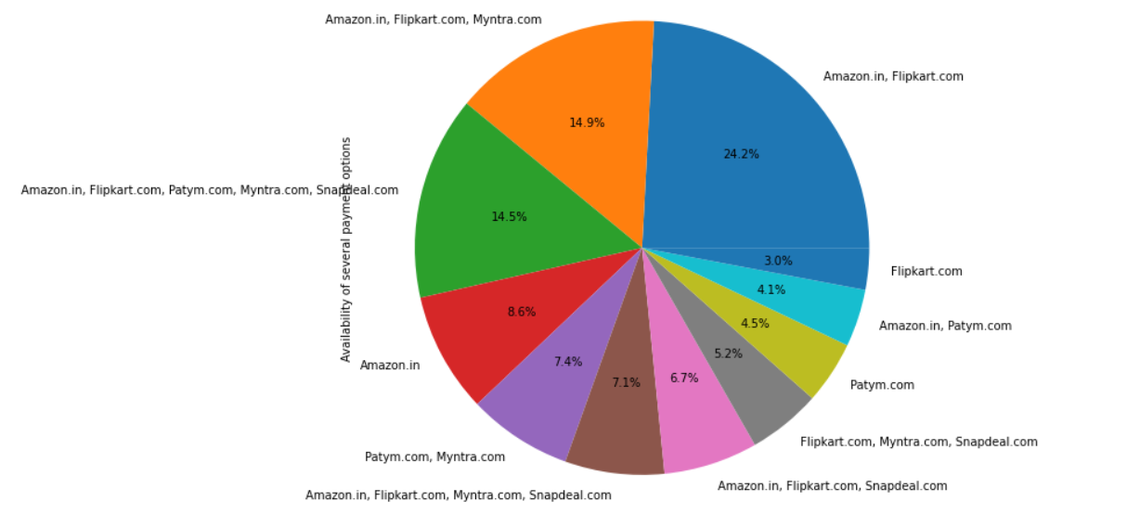
Quickness to complete purchase
Availability of several payment options

Slide 21
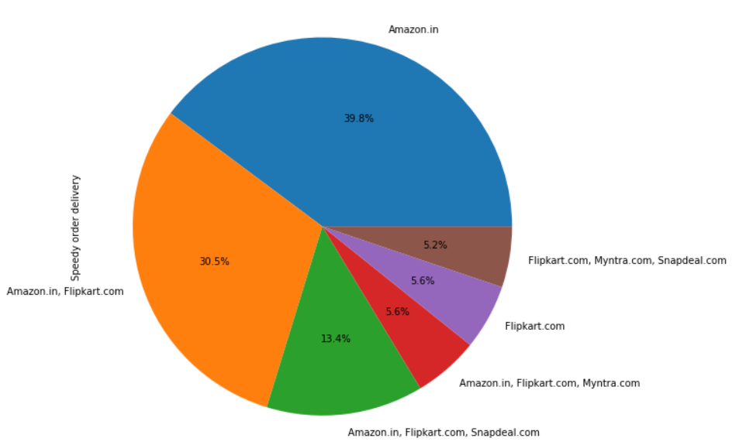
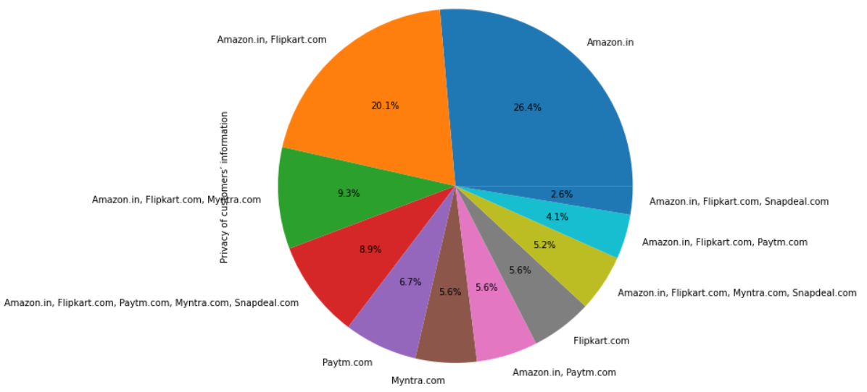
Speedy order delivery
Privacy of customers’ information

Slide 22
OBSERVATIONS:-
IN EASY TO USE WEBSITE OF APPLICATION AMAZON.IN,FLIP.COM,PAYTM.COM,MYNTRA.COM,SNAPDEAL.COM TAKE 23.8%
IN VISUAL APPEARING WEBPAGE LAYOUT AMAZON.IN AND FLIPKART.COM TAKE MAJORITY 32%
IN WILD VARIETY OF PRODUCT ON OFFER AMAZON.IN AND FLIPKART.COM TAKEN 48.3%
IN COMPLETE RELEVANT DESCRIPTION INFORMATION OF PRODUCTS AMAZON.IN AND FLIPKART TAKEN 37.2%
IN FAST LOADINGWEBSITE SPEED OF WEBSITE AND APPLICATION AMAZON TAKEN 19% AND AMAZON+PAYTM TAKEN 16.4%
IN REALIBILITY OF THE WEBSITE OR APPLICATION AMAZON TAKEN 22.7%
IN QUICKNESS TO COMPLETE PURCHASE AMAZON TAKEN 24.5%
IN AVAILABILITY OF SEVERAL PAYMENT OPTIONS AMAZON AND FLIPKART TAKEN 24.2%
IN SPEED ORDER DELEVERY AMAZON TAKEN 39.8%
IN PRIVACY OF CUSTOMERS INFORMATION AMAZON TAKEN 26.4%
FROM THE ABOVE DATA WE CAN CONCLUDE THAT AMAZON DOING WELL IN EVERY AREA
FLIPKART IN SOME PALCE LIKE ‘AVAILABILITY OF SEVERAL PAYMENT OPTIONS’ , ‘VISUAL APPEARING WEBPAGE LAYOUT’ , ‘WILD VARIETY OF PRODUCT ON OFFER’ , ‘COMPLETE RELEVANT DESCRIPTION INFORMATION OF PRODUCTS.
IN EASY TO USE WEBSITE OF APPLICATION ALL THE WEB SITE DOING WELL

Slide 23
on the basis of society:-
In this section we will analyse features related to customer service & add on by ecommerce company like communication channel, readiness to resolve customer query. Following features, we have analysed in this section:
1. Empathy (readiness to assist with queries) towards the customers
2. Being able to guarantee the privacy of the customer
3. Responsiveness, availability of several communication channels (email, online rep, twitter, phone etc.)
4. Online shopping gives monetary benefit and discounts
5. Enjoyment is derived from shopping online
6. Shopping online is convenient and flexible
7. Return and replacement policy of the e-tailer is important for purchase decision
8. Gaining access to loyalty programs is a benefit of shopping online
9. Displaying quality Information on the website improves satisfaction of customers
10.User derive satisfaction while shopping on a good quality website or application
11.Net Benefit derived from shopping online can lead to users’ satisfaction
12.User satisfaction cannot exist without trust

Slide 24
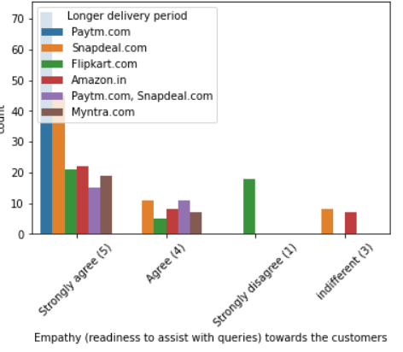
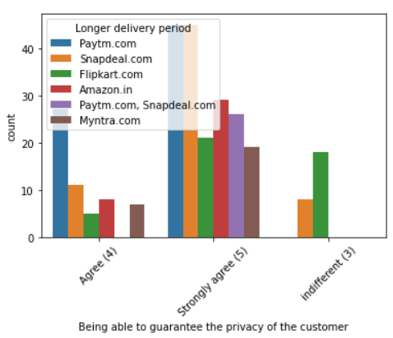
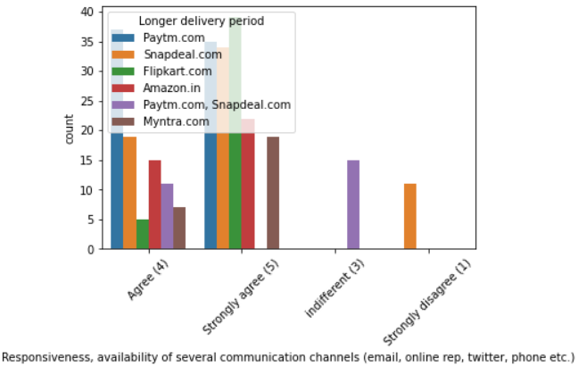
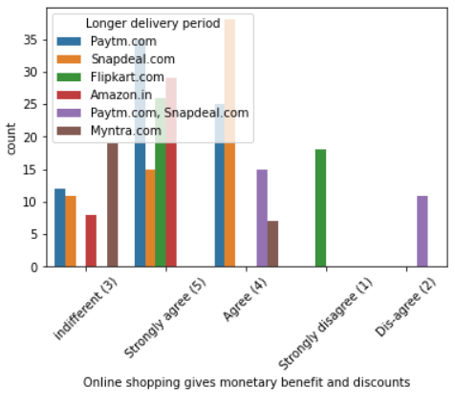
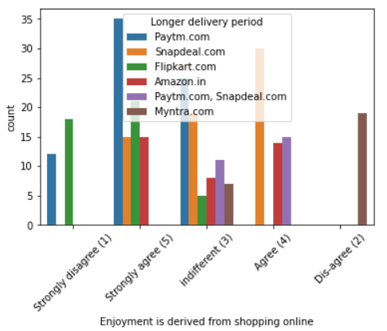
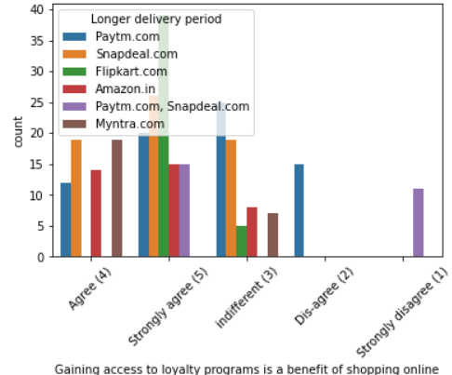

Slide 25
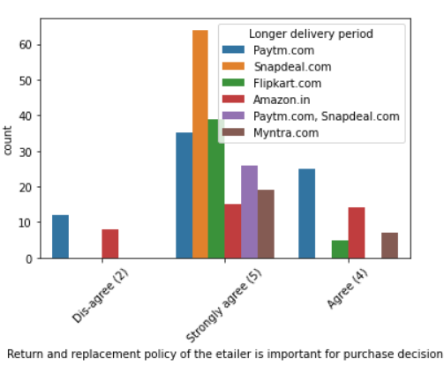
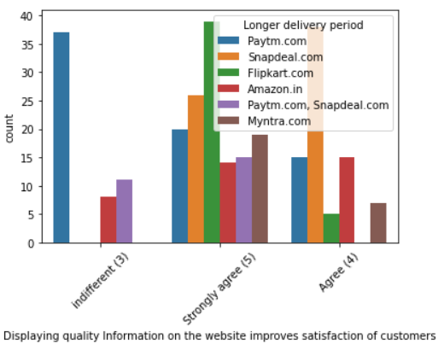
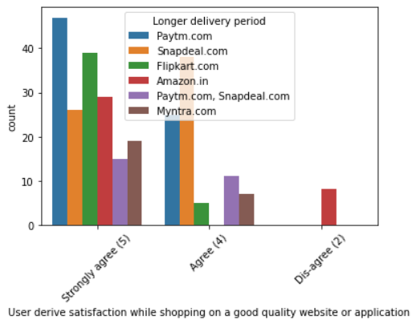
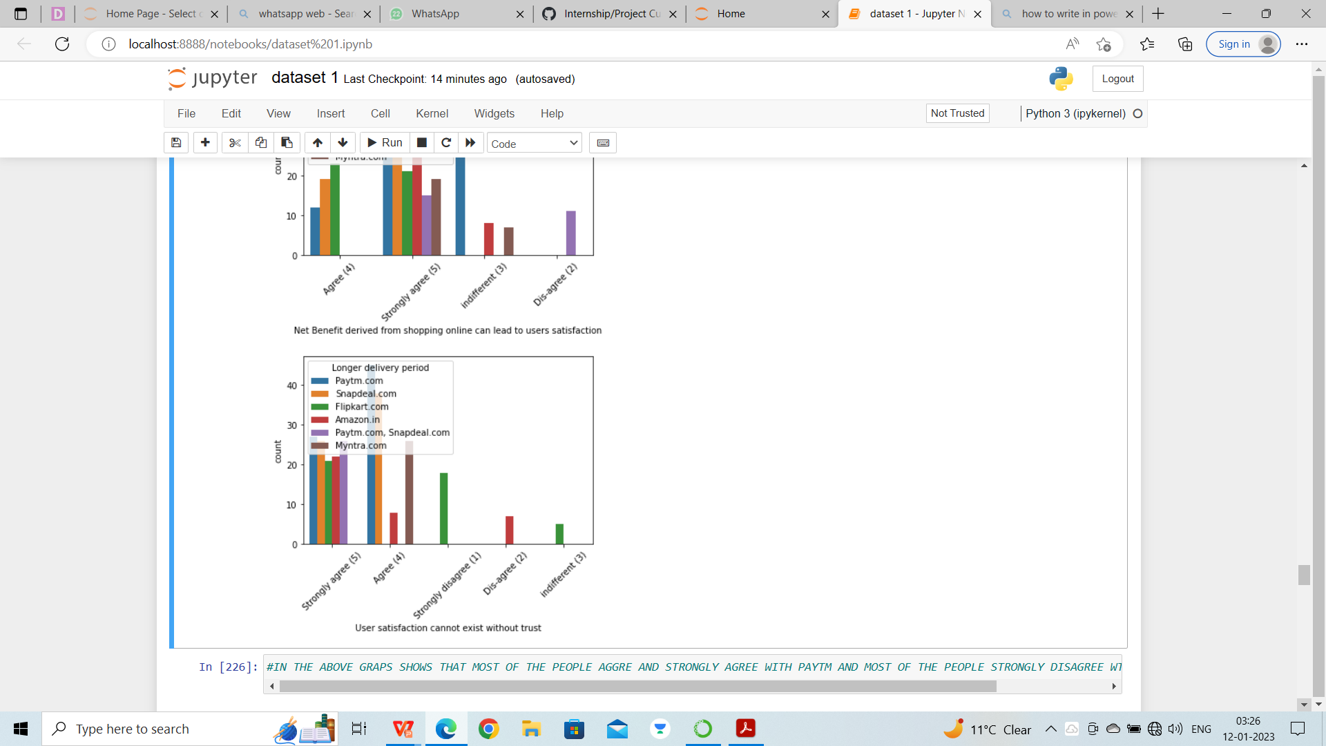
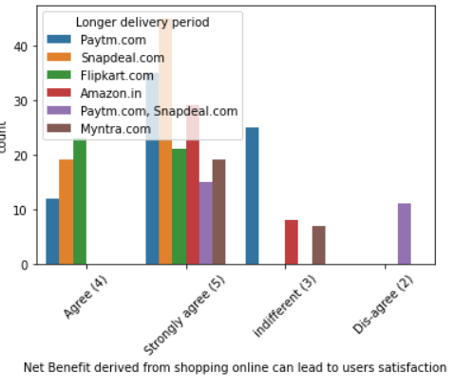
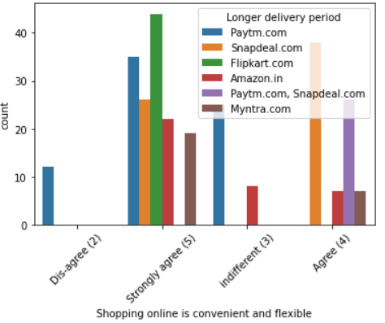

Slide 26
observation:-
IN Empathy (readiness to assist with queries) towards the customers people strongly agree with paytm and strongly
disagree with flipkart
IN Being able to guarantee the privacy of the customer strongly agree with paytm and amazon and indifferent with
flipkart
IN Responsiveness, availability of several communication channels (email, online rep, twitter, phone etc.) strongly
with flipkart and strongly disagree with snapdeal
IN Online shopping gives monetary benefit and discounts strongly agree with paytm and strongly with fkipkart
IN Enjoyment is derived from shopping online strongly agree with paytm and strongly with amazon
IN Shopping online is convenient and flexible storngly agree with flipkart and disagree with paytm
IN Return and replacement policy of the e-tailer is important for purchase decision strongly agree with snapdeal and
disagree with paytm
IN Gaining access to loyalty programs is a benefit of shopping online strongly agree with flipkart and disagree with
paytm
IN Displaying quality Information on the website improves satisfaction of customers strongly agree with flipkart and
disagree with paytm
IN User derive satisfaction while shopping on a good quality website or application strongly agree with paytm and disagree
with amazon
IN Net Benefit derived from shopping online can lead to users’ satisfaction strongly agree with snapdeal and disagree with
paytm and snapdeal
IN User satisfaction cannot exist without trust strongly agree with snapdeal and paytm and disagree with amazon

